Slide 1
Twitter: Real or Fake?
Group Members: Michael Kinkoph, Josh Sefton, Morgan Soladine
Mentor: Hani Dawoud

Slide 2
Group Video
http://screencast.com/t/lpaXZwpvg9qC

Slide 3
Question
Our goal is to find out whether people following parody accounts know the real counterpart or not. If they know, why do they still follow that parody?

Slide 4
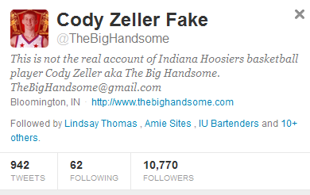
What is a parody account?
A parody account is an imitation of the style of a particular writer, artist, or genre with deliberate exaggeration for comic effect. These accounts can be made by any users on Twitter and normally are left public so anyone can follow these accounts

Slide 5
Purpose
The main point of our research is to figure out why users create these accounts and how influential the information is on people. We are interested with the phenomenon of parodies and how they gain so much attention from the public and have followers of 200,000 and more.

Slide 6
Importance
Since Twitter is a key mean in spreading information/knowledge, it’s vital to know to what extent people do consume false information.

Slide 7
Methodology
First Phase: For the first part of our research we created a survey that asked questions about parody accounts, if they knew they were following parody accounts, etc. Our basic idea was to eventually compare survey answers to a much larger data set.

Slide 8
Methodology: Survey
For our Survey we asked 5 simple questions:
Do you follow a parody account on Twitter? yes or no? If yes, why?
Parody Account: In this case, a parody account is an account that imitates a celebrity for the purpose of mocking them or their original work.
2. How many Twitter parody accounts do you follow?
3. Did you know that you were following a parody account versus the real account? If yes, how?
4. Do you think that following these parody accounts allows you to learn more about the celebrities? If yes, why?
5. What is your main reason for following a parody account?

Slide 9
Survey Results

Slide 10
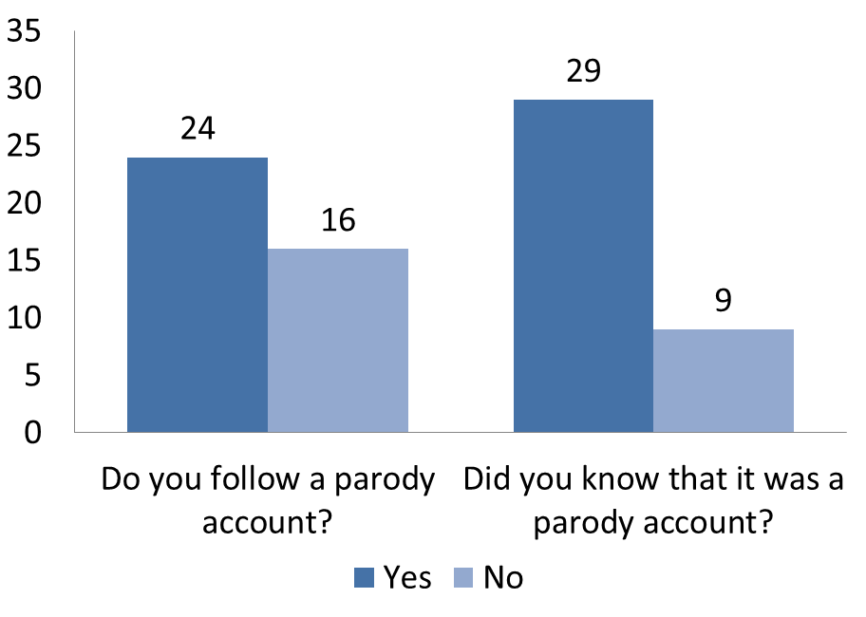
Survey Results

Slide 11
Survey Results

Slide 12
What’s it all mean?
Majority of people either follow many parody accounts or zero parody accounts at all.
Mostly all of those people that do follow a parody account knew it was a parody account.
People do not gain information from these parody accounts, but usually just follow them for humor.

Slide 13
Survey Limitations
The survey was conducted over a short period of time and did not return much data.
Our survey set was mainly college students which gave us a bias result of information. College students are probably more aware of social media sites. They may use social media sites to connect with people rather than use it for news which was out of the scope of our research.

Slide 14
Methodology
Second Phase: For the second part of our research we used automatic data mining, which is the process of discovering new patterns from large data sets involving methods of statistics and database systems. Our overall goal of the automatic data mining process is to extract knowledge from a data set in a human-understandable structure.

Slide 15
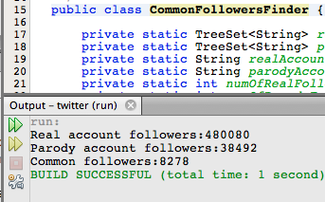
Process
Our mentor Hani helped with the process of crawling through the html using Java.
Using twitter’s API it allowed us to quickly crawl through the followers of both the 10 real and 10 parody account’s that we chose.

Slide 16
Twitter accounts
@Lil_tunechi Lil Wayne:
Real account followers:6256703
Parody account followers:132597
Common followers:65017
@Beyonce Beyonce Knowles:
Real account followers:3798424
Parody account followers:163611
Common followers:87009
@jason_aldean Jason Aldean:
Real account followers:432664
Parody account followers:39916
Common followers:18108
@drake Drake:
Real account followers:6620594
Parody account followers:114824
Common followers:46877
@miranda_lambert Miranda Lambert:
Real account followers:840603
Parody account followers:28766
Common followers:16858
@officialadele Adele:
Real account followers:5352206
Parody account followers:38801
Common followers:16841
@realwizkhalifa Wiz Khalifa:
Real account followers:5319478
Parody account followers:88120
Common followers:64735
@rickyrozay Rick Ross:
Real account followers:2113980
Parody account followers:37084
Common followers:17156
@S_C_ Jay-z:
Real account followers:1686625
Parody account followers:726068
Common followers:134144
@wizardcud Kid Cudi:
Real account followers:480080
Parody account followers:38492
Common followers:8278

Slide 17
About the accounts
We chose artists because they have a large amount of followers and are very influential.
All of the real accounts we chose are verified. (verification process)
The parody accounts are not verified but they are public accounts which allowed us to use twitter’s API to find the followers.

Slide 18
Data Mining Results
This chart shows the percentage of common followers between an artists real account and parody account. So, for Lil Wayne out of all his parody followers, 49% follow his real account. We used a percentage because of the amount of followers vary from account to account.

Slide 19
Data Mining Results
As you can see most of the parody account followers are not aware of the real one.

Slide 20
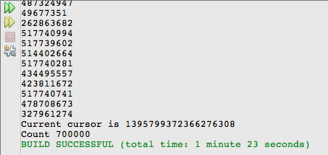
Limitations
With the Twitter API we were only allowed to request for 5000 followers 140 times per hour.
This limited us to only finding 700,000 followers per hour, which became time consuming for certain accounts.

Slide 21
Insights
Besides finding out that people are unaware they are following real accounts or parody accounts we concluded they may not necessarily consume false information. A lot of times parody accounts aren’t a parody at all and give out other information.
For musical artists on twitter judging by how many people follow both their real and parody we can judge how strong their fan base is.

Slide 22
Our own parody account
We made our own parody account of a Sports Illustrated Swimsuit model.
We obtained a small amount of followers during this semester due to time restraints.
Also, we found you can only follow so many people per day which limited the number of followers we could get back.
Lastly, it was very difficult to come up with a creative name for any celebrity because so many people have made varying parody account names of celebrities.

Slide 23
The future
Twitter is going to continue to shape the way people absorb information.
Whether or not people are absorbing true or false information depends on the users knowledge of how to correctly use the website.
We decided parody accounts are not necessarily a bad thing. But, if people are not aware the information is false they are receiving this could become a major issue.

Slide 24
Questions?

